Slide 1
Campus Recruitment Analysis
By
Divya Dongala
Pragati Gupta
Data Mining Project

Slide 2
Campus Recruitment Analysis
This Analysis contains Student unique Id, School Percentage, Degree details and Work experience as well as salary detail.
This analysis will help HR of the university to understand:
Q1. Which specialization gets max amount salary?
Q2. Who is getting more pay between Male and female?
Q3. Reasons for the students who are not getting placement?

Slide 3
Data Set
IntroDuction Of data Set
This Data is collected from various websites of a university which include data from many department like Arts, Scinece, Marketing anf Fincace, Marketing HR. (downloaded from Kaggel).
Data Set1 and Data set2
+
After Integration : Final DataSet

Slide 4
Pre- Processing
Cleaning
Data Integration
Data Summarization
Merged Data Set1 and Data Set2
Get Final Data Set
Removed Missing (Blank Space) Values
Remove Unknow Values (Nan,Na,na,None)
Worked on Noise Data
Calculated Mean, Mode, Media
Data Bining based of Distance
Data Transformation
Dimensionality Reduction
Normalization
Performed Binning
Removed unwanted columns
Pivot Charts for visualization

Slide 5
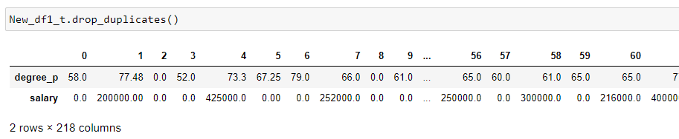
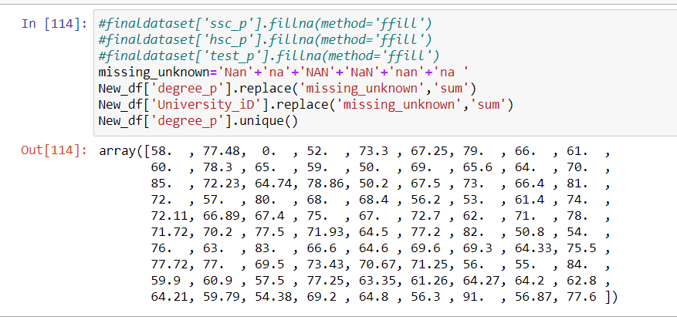
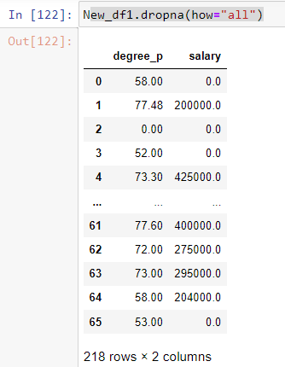
Cleaning
Removed Missing (Blank Space) Values.
Remove Unknow Values (Nan,Na,na,None).
Worked on Noise Data.

Slide 6
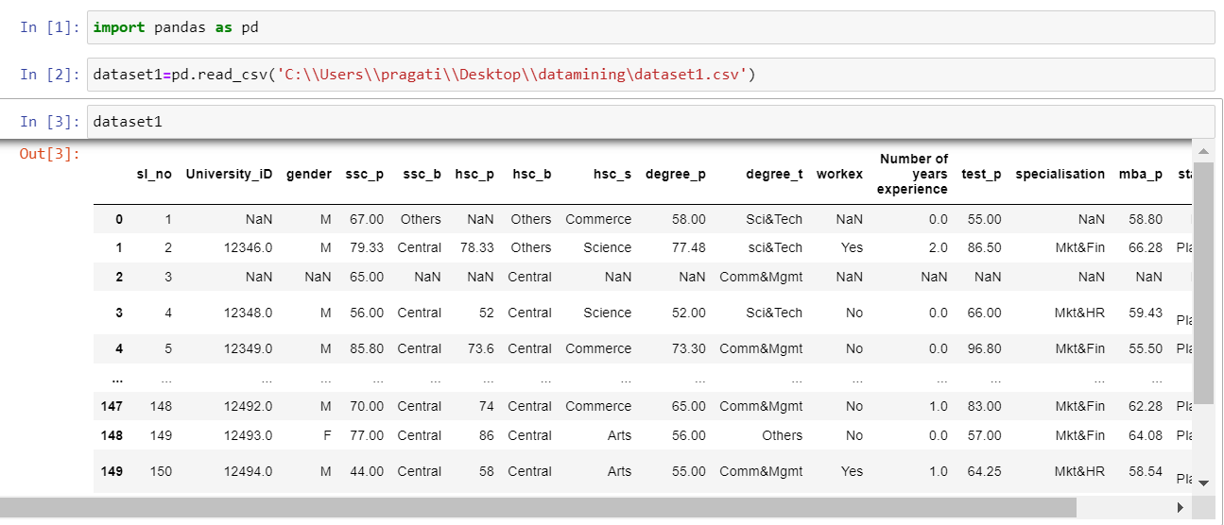
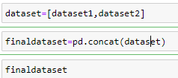
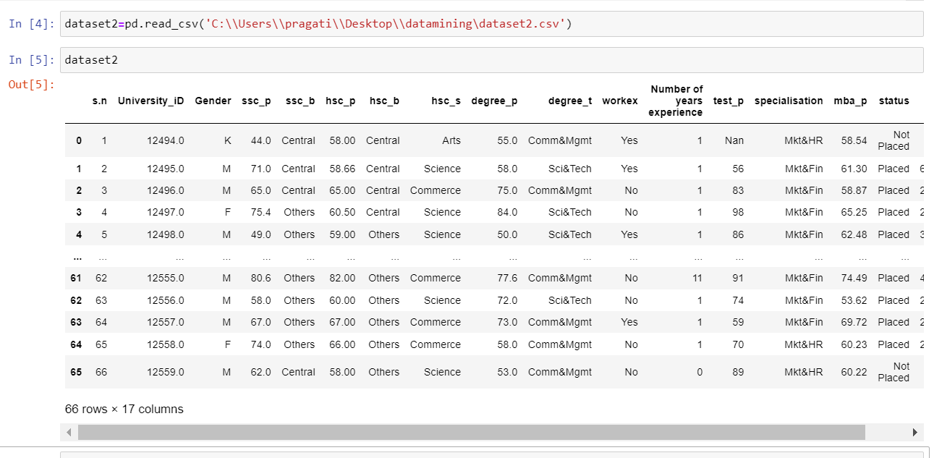
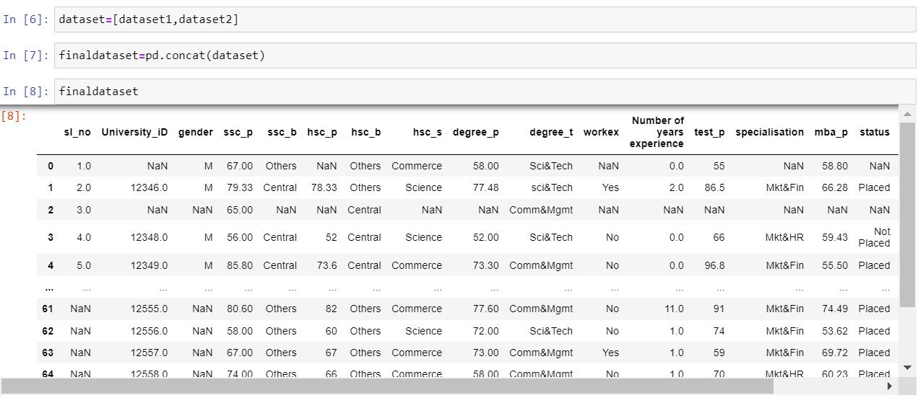
Data Integration
Data Set1
Data Set2
Final Data Set

Slide 7
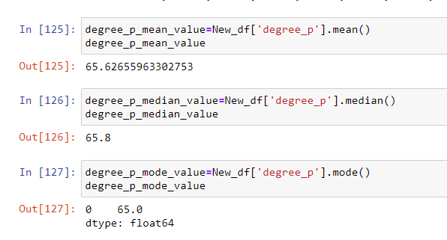
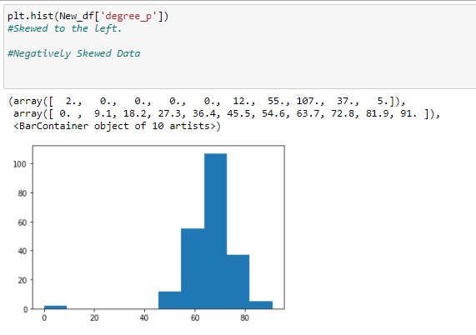
Data Summarization
Mean, Mode, Media
Negatively Skewed
Unimodal

Slide 8
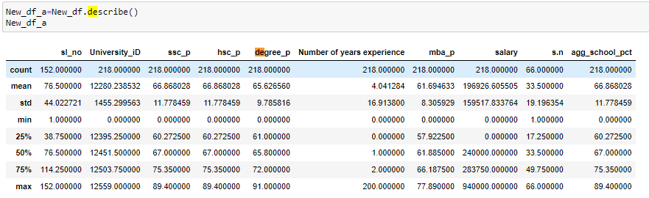
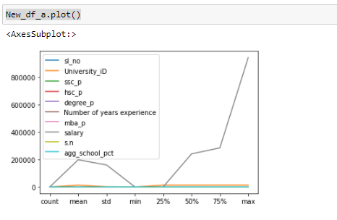
Data Summarization

Slide 9
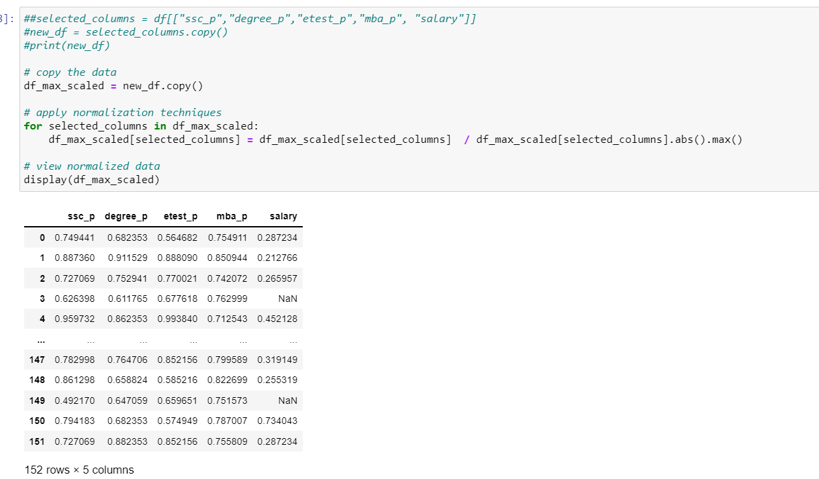
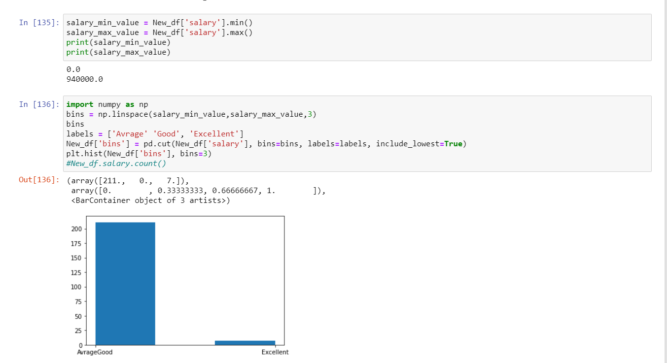
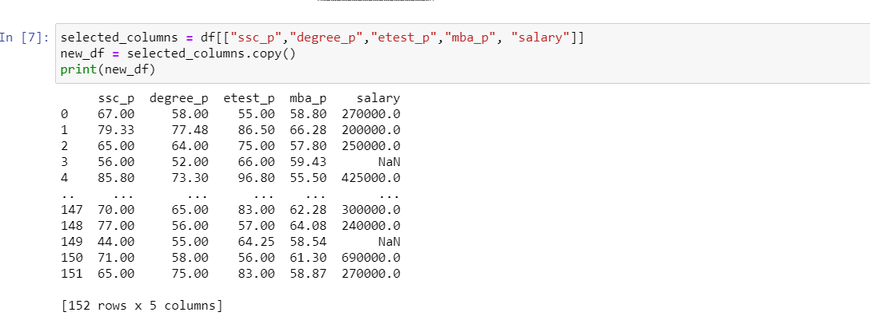
Data Transformation
Normalization
Performed Binning

Slide 10
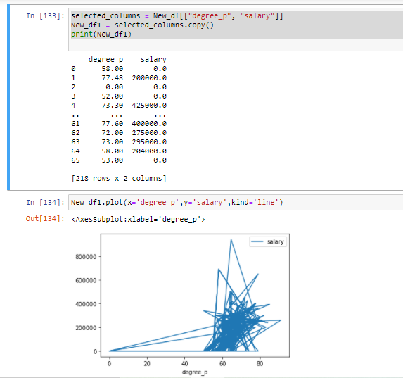
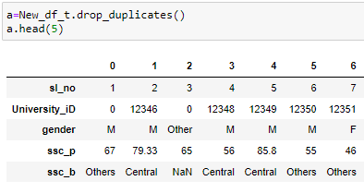
Dimensionality Reduction

Slide 11
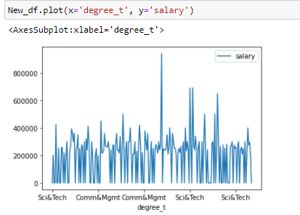
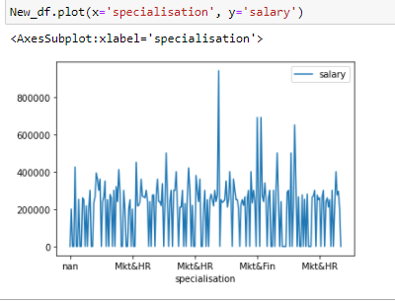
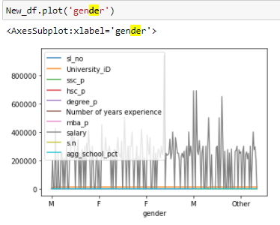
Outcomes
Goals: to access student data from the various sources, predict achievement levels and find students or groups of students which need extra attention.
Q1. Which specialization getting max amount salary?
Ans: communication & management department have got greatest package.
For students who are specialized in a particular field the maximum package have got by mkt & hr.
Q2. Who is getting more pay between Male and female?
Ans: Male
Q3. Reasons for the students who are not getting placement?
Ans: The student less then 40pct in degree/ school /specialization are not getting campus selection.

Slide 12
References
Data Set Collected
Kaggel
Tools/Software
Microsoft Word, Power Point, Excel
Jupiter Notebook, Python, Panda, MATLAB, NumPy,
Material
Internet, Course Book, Python.org, W3 School, Notes,
Other Helps
NA

Slide 13
THANK YOU
Team: The Data Scientist
Divya Dongala
Pragati Gupta

